Slide 1
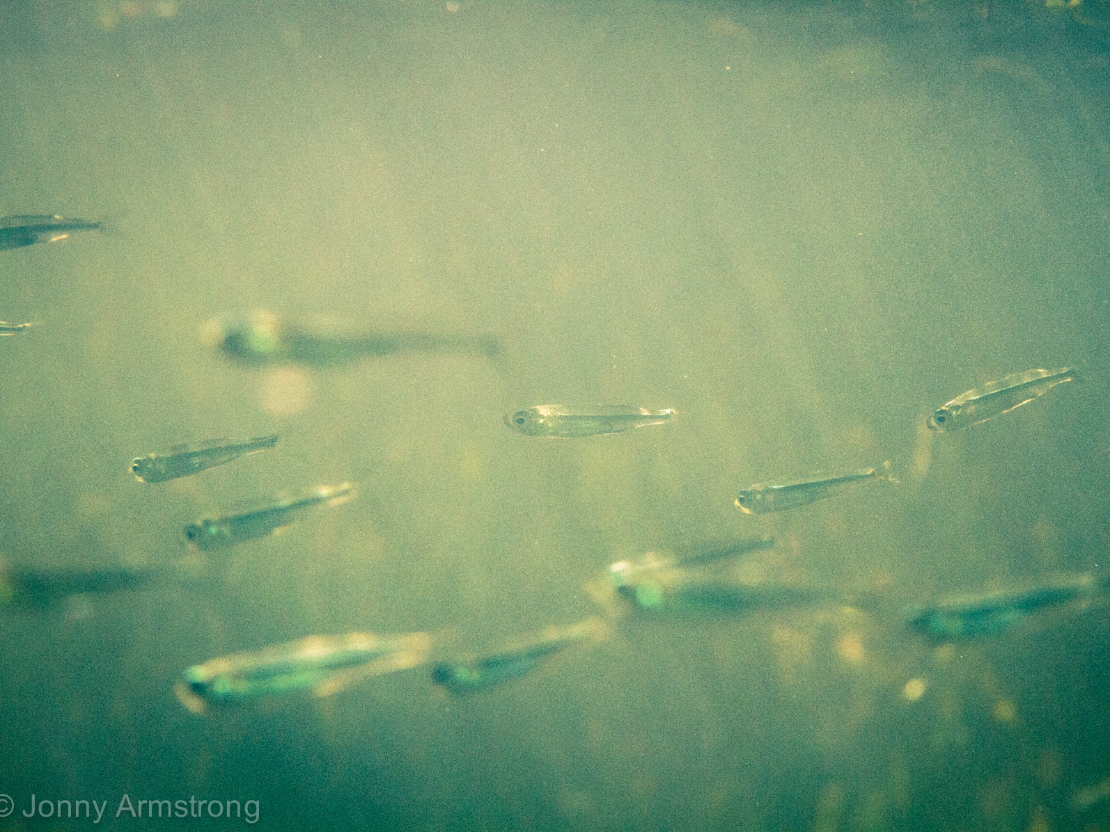
Generalized graphical mixed models combine strengths from causal, additive, and linear mixed models
James T Thorson

Slide 2
Prediction
E.g. regression models
Used to interpolate
Density in an SDM
Age-structure in population dynamics
Inference
E.g. bespoke models
Used to estimate parameters
Stock-recruit compensation
Production per biomass
Causal analysis
E.g., policy analysis
Used to predict response to new conditions
Impact of rebuilding plan
Habitat restoration

Slide 3
Three goals for ecological analysis
Common types of ecological model
Goal | Spatial example | Population dynamics example
Prediction | Interpolate density in species distribution model | Estimate age-structure in year without samples
Inference | Estimate spatial decorrelation range | Estimate the stock-recruit curve
Causal analysis | Predict consequences for habitat restoration | Predict response to future climate conditions
Model | Spatial example | Population dynamics example
Linear mixed model | Analysis of experimental design | Recruitment deviations as random variation around stock-recruit curve
Generalized additive model | Dome-shaped response to thermal habitat | Time-varying selectivity curve
Structural equation model | Habitat effects in site-replicated design | -

Slide 4
Three common types of model:
Model | Spatial example | Population dynamics example
Linear mixed model | Analysis of experimental design | Recruitment deviations as random variation around stock-recruit curve
Generalized additive model | Dome-shaped response to thermal habitat | Time-varying selectivity curve
Structural equation model | Habitat effects in site-replicated design | -
Goal:
Identify single modelling framework with strengths of LMMs, GAMs, and SEMs, and suitable for prediction, inference, and causal analysis

Slide 5
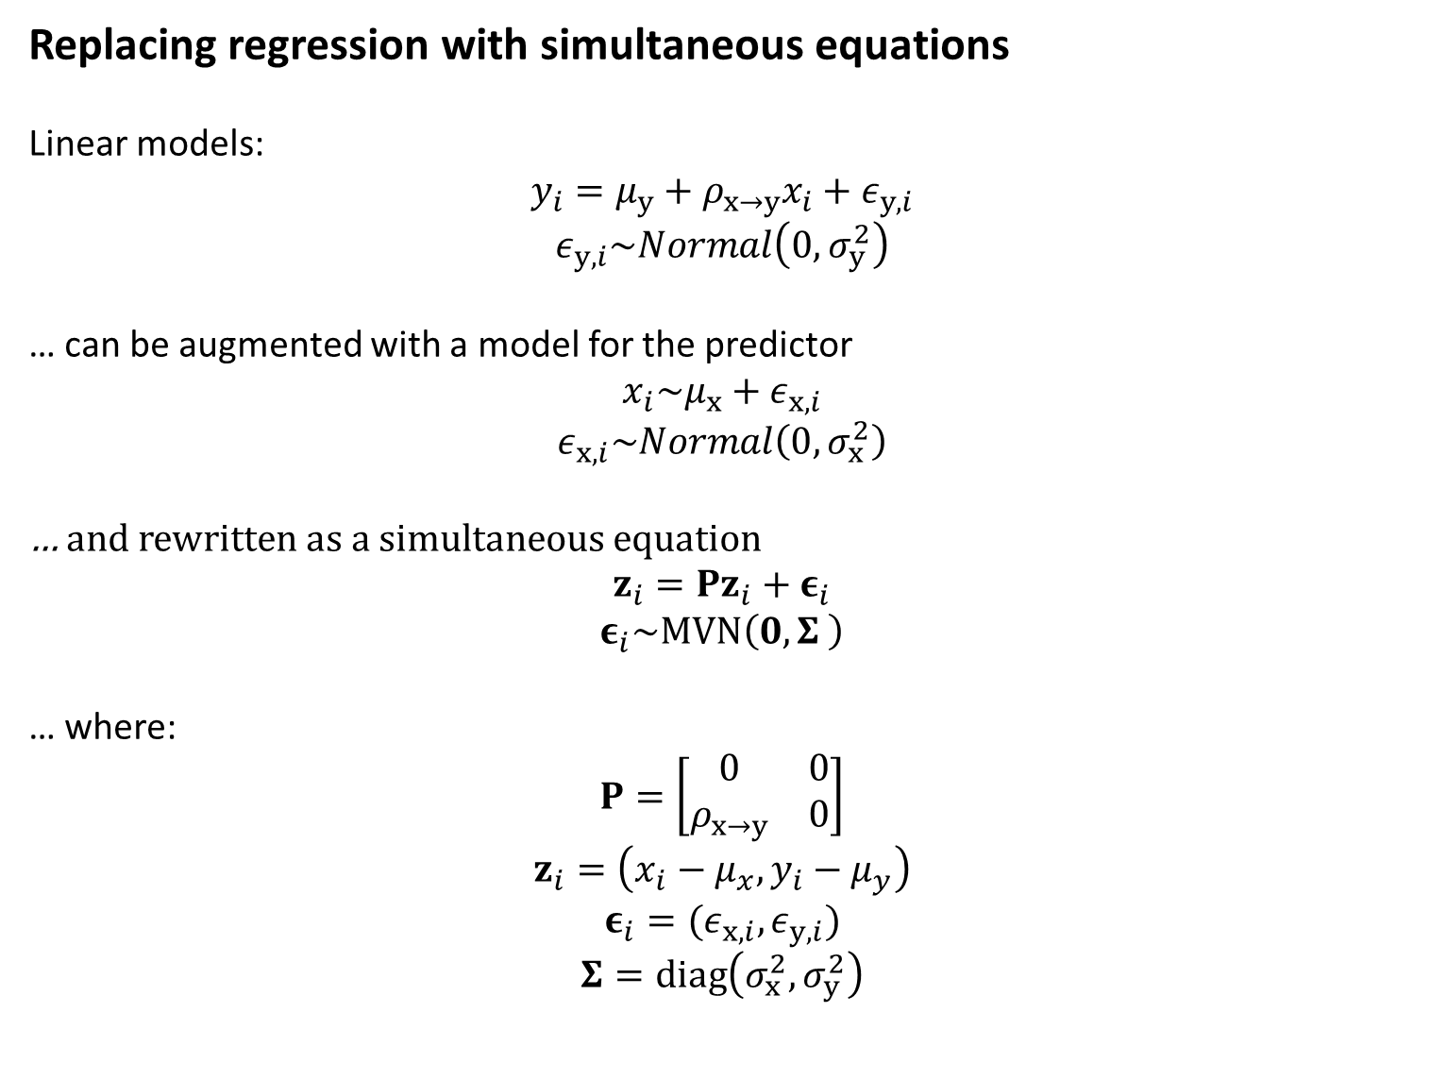
Replacing regression with simultaneous equations
Linear models:
$$y_{i}=μ_{y}+ρ_{x→y}x_{i}+ε_{y,i}$$
$$ε_{y,i}\sim Normal\left(0,σ_{y}^{2}\right)$$
… can be augmented with a model for the predictor
$$x_{i}\sim μ_{x}+ε_{x,i}$$
$$ε_{x,i}\sim Normal\left(0,σ_{x}^{2}\right)$$
… and rewritten as a simultaneous equation
$$z_{i}=Pz_{i}+ε_{i}$$
$$ε_{i}\sim MVN\left(0,Σ \right)$$
… where:
$$P=\left[\begin{matrix}0 & 0 \\ ρ_{x→y} & 0\end{matrix}\right]$$
$$z_{i}=\left(x_{i}−μ_{x},y_{i}−μ_{y}\right)$$
$$ε_{i}=(ε_{x,i},ε_{y,i})$$
$$Σ=diag\left(σ_{x}^{2},σ_{y}^{2}\right)$$

Slide 6
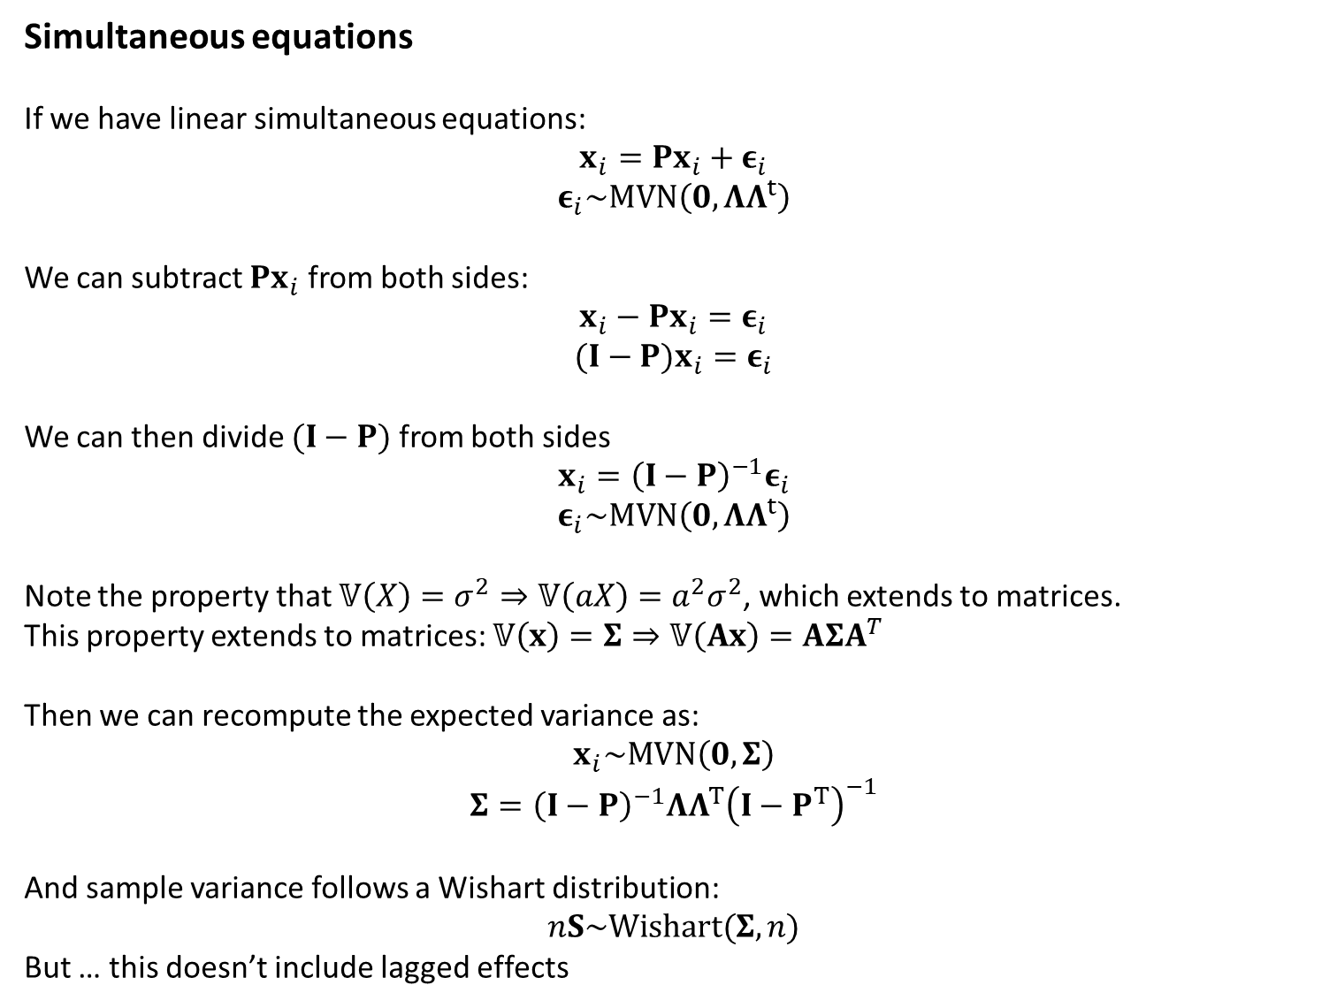
Simultaneous equations
If we have linear simultaneous equations:
$$x_{i}=Px_{i}+ε_{i}$$
$$ε_{i}\sim MVN\left(0,ΛΛ^{t}\right)$$
We can subtract $Px_{i}$ from both sides:
$$x_{i}−Px_{i}=ε_{i}$$
$$(I−P)x_{i}=ε_{i}$$
We can then divide $(I−P)$ from both sides
$$x_{i}={\left(I−P\right)}^{−1}ε_{i}$$
$$ε_{i}\sim MVN\left(0,ΛΛ^{t}\right)$$
Note the property that $𝕍\left(X\right)=σ^{2}⇒𝕍\left(aX\right)={a^{2}σ}^{2}$, which extends to matrices.
This property extends to matrices: $𝕍\left(x\right)=Σ⇒𝕍\left(Ax\right)=AΣA^{T}$
Then we can recompute the expected variance as:
$$x_{i}\sim MVN\left(0,Σ\right)$$
$$Σ={\left(I−P\right)}^{−1}ΛΛ^{T}{\left(I−P^{T}\right)}^{−1}$$
And sample variance follows a Wishart distribution:
$$nS\sim Wishart(Σ,n)$$
But … this doesn’t include lagged effects

Slide 7
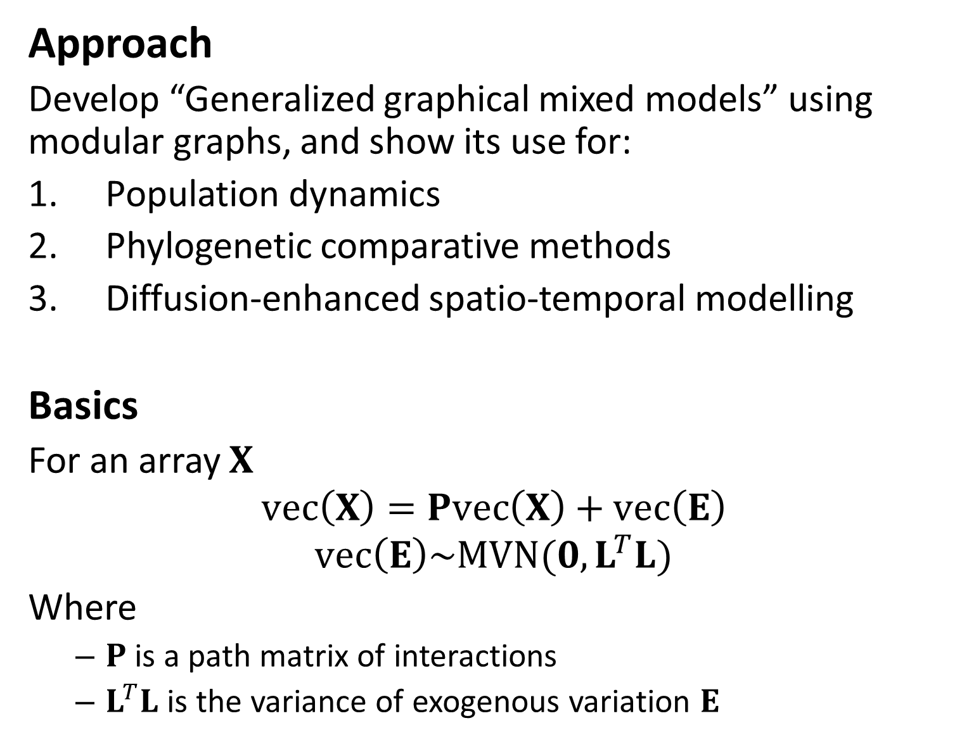
Approach
Develop “Generalized graphical mixed models” using modular graphs, and show its use for:
Population dynamics
Phylogenetic comparative methods
Diffusion-enhanced spatio-temporal modelling
Basics
For an array $X$
$$vec\left(X\right)=Pvec\left(X\right)+vec\left(E\right)$$
$$vec\left(E\right)\sim MVN(0,L^{T}L)$$
Where
$P$ is a path matrix of interactions
$L^{T}L$ is the variance of exogenous variation $E$

Slide 8
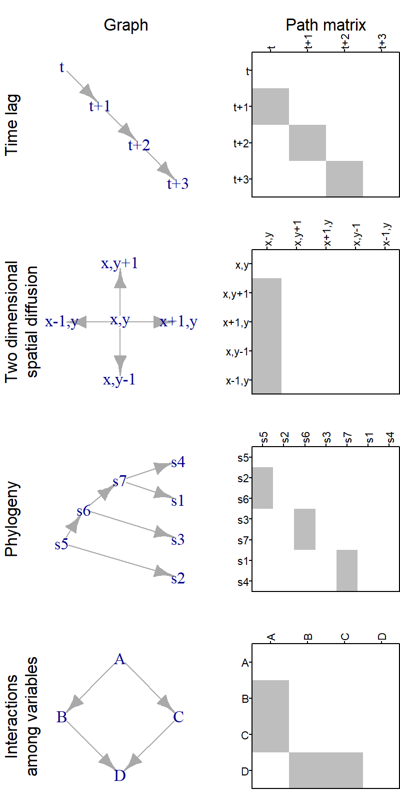
Common types of graph
We can calculate the interaction of any set of graphs

Slide 9
Three examples
Age-structured dynamics
Predict abundance-at-age in years with no data
Trade-offs among species traits
Predict missing traits using evolutionary relatedness and ecological trade-offs
Diffusion in spatio-temporal model
Estimate how hotspots propagate over time

Slide 10
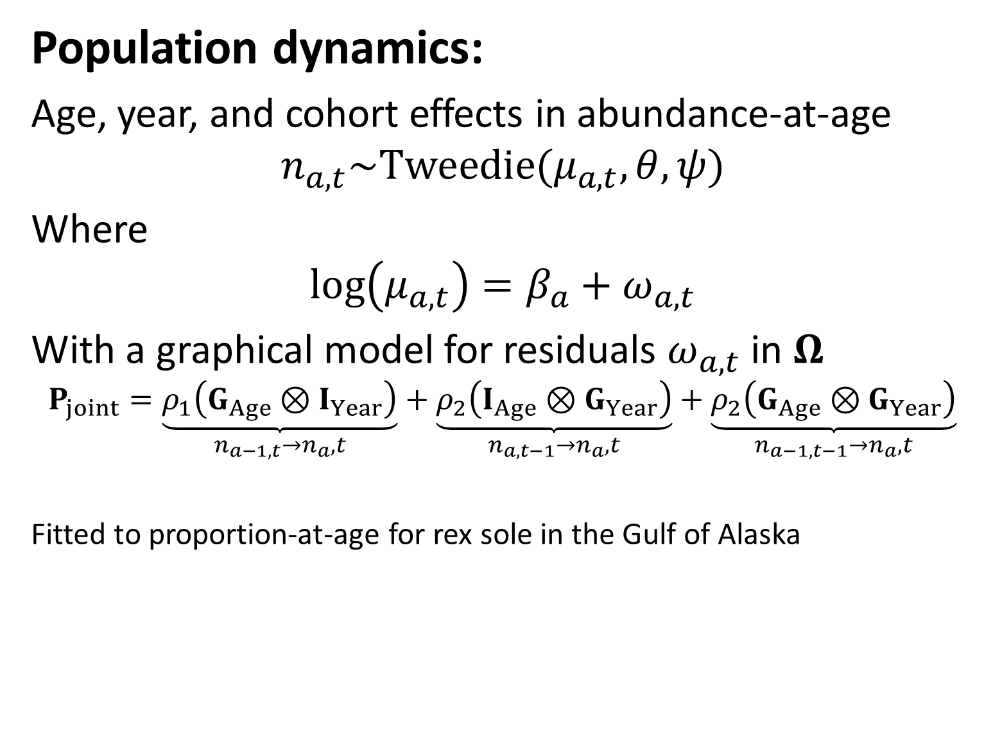
Population dynamics:
Age, year, and cohort effects in abundance-at-age
$$n_{a,t}\sim Tweedie(μ_{a,t},θ,ψ)$$
Where
$$\log\left(μ_{a,t}\right)=β_{a}+ω_{a,t}$$
With a graphical model for residuals $ω_{a,t}$ in $Ω$
$$P_{joint}=\underset{n_{a−1,t}→n_{a},t}{\underbrace{ρ_{1}\left(G_{Age}⊗I_{Year}\right)}}+\underset{n_{a,t−1}→n_{a},t}{\underbrace{ρ_{2}\left(I_{Age}⊗G_{Year}\right)}}+\underset{n_{a−1,t−1}→n_{a},t}{\underbrace{ρ_{2}\left(G_{Age}⊗G_{Year}\right)}}$$
Fitted to proportion-at-age for rex sole in the Gulf of Alaska

Slide 11
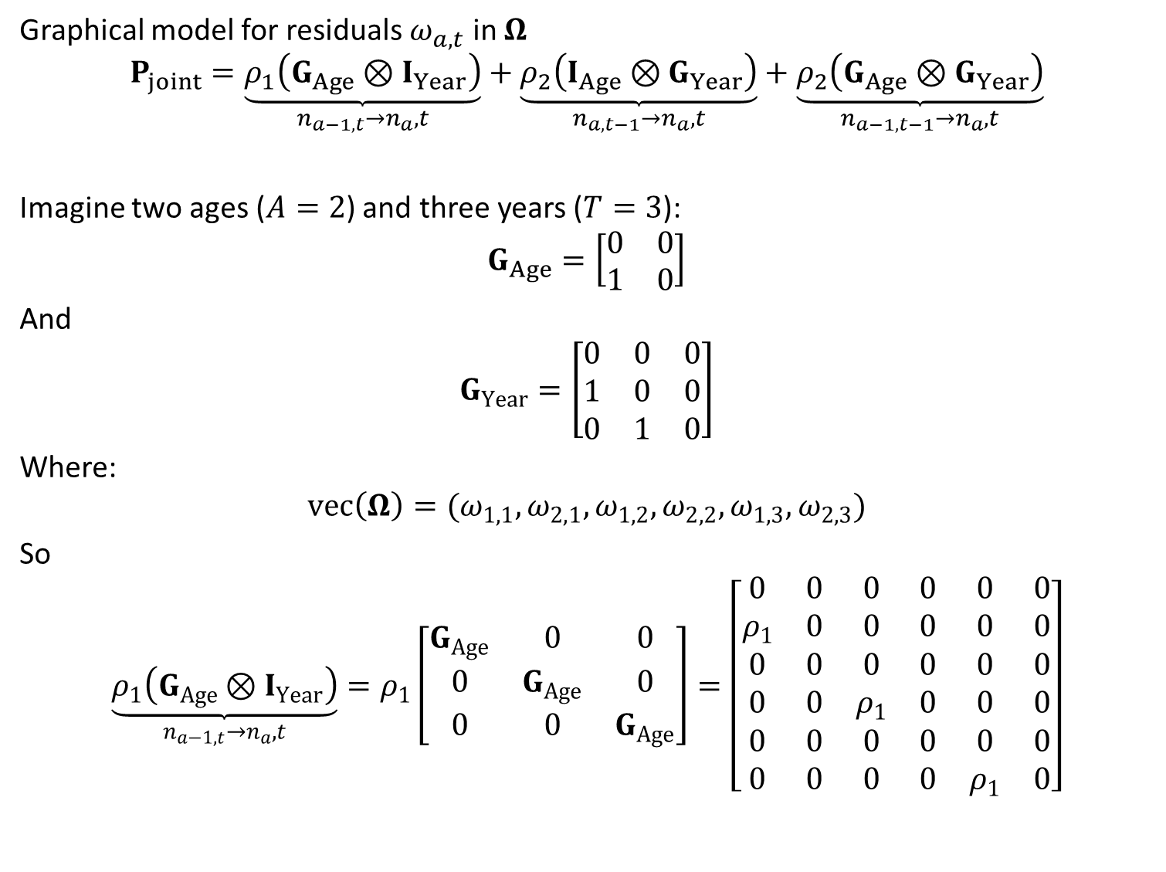
Graphical model for residuals $ω_{a,t}$ in $Ω$
$$P_{joint}=\underset{n_{a−1,t}→n_{a},t}{\underbrace{ρ_{1}\left(G_{Age}⊗I_{Year}\right)}}+\underset{n_{a,t−1}→n_{a},t}{\underbrace{ρ_{2}\left(I_{Age}⊗G_{Year}\right)}}+\underset{n_{a−1,t−1}→n_{a},t}{\underbrace{ρ_{2}\left(G_{Age}⊗G_{Year}\right)}}$$
Imagine two ages ($A=2$) and three years ($T=3$):
$$G_{Age}=\left[\begin{matrix}0 & 0 \\ 1 & 0\end{matrix}\right]$$
And
$$G_{Year}=\left[\begin{matrix}0 & 0 & 0 \\ 1 & 0 & 0 \\ 0 & 1 & 0\end{matrix}\right]$$
Where:
$$vec\left(Ω\right)=(ω_{1,1},ω_{2,1},ω_{1,2},ω_{2,2},ω_{1,3},ω_{2,3})$$
So
$$\underset{n_{a−1,t}→n_{a},t}{\underbrace{ρ_{1}\left(G_{Age}⊗I_{Year}\right)}}=ρ_{1}\left[\begin{matrix}G_{Age} & 0 & 0 \\ 0 & G_{Age} & 0 \\ 0 & 0 & G_{Age}\end{matrix}\right]=\left[\begin{matrix}0 & 0 & 0 & 0 & 0 & 0 \\ ρ_{1} & 0 & 0 & 0 & 0 & 0 \\ 0 & 0 & 0 & 0 & 0 & 0 \\ 0 & 0 & ρ_{1} & 0 & 0 & 0 \\ 0 & 0 & 0 & 0 & 0 & 0 \\ 0 & 0 & 0 & 0 & ρ_{1} & 0\end{matrix}\right]$$

Slide 12
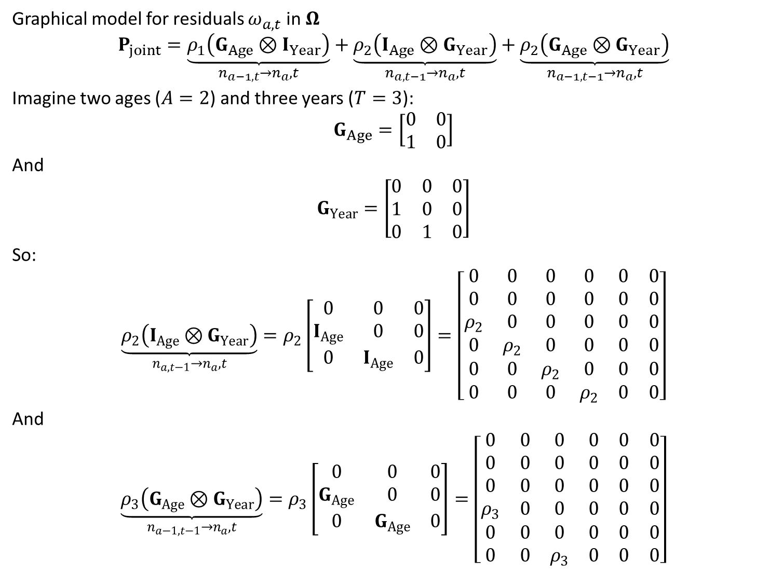
Graphical model for residuals $ω_{a,t}$ in $Ω$
$$P_{joint}=\underset{n_{a−1,t}→n_{a},t}{\underbrace{ρ_{1}\left(G_{Age}⊗I_{Year}\right)}}+\underset{n_{a,t−1}→n_{a},t}{\underbrace{ρ_{2}\left(I_{Age}⊗G_{Year}\right)}}+\underset{n_{a−1,t−1}→n_{a},t}{\underbrace{ρ_{2}\left(G_{Age}⊗G_{Year}\right)}}$$
Imagine two ages ($A=2$) and three years ($T=3$):
$$G_{Age}=\left[\begin{matrix}0 & 0 \\ 1 & 0\end{matrix}\right]$$
And
$$G_{Year}=\left[\begin{matrix}0 & 0 & 0 \\ 1 & 0 & 0 \\ 0 & 1 & 0\end{matrix}\right]$$
So:
$$\underset{n_{a,t−1}→n_{a},t}{\underbrace{ρ_{2}\left(I_{Age}⊗G_{Year}\right)}}=ρ_{2}\left[\begin{matrix}0 & 0 & 0 \\ I_{Age} & 0 & 0 \\ 0 & I_{Age} & 0\end{matrix}\right]=\left[\begin{matrix}0 & 0 & 0 & 0 & 0 & 0 \\ 0 & 0 & 0 & 0 & 0 & 0 \\ ρ_{2} & 0 & 0 & 0 & 0 & 0 \\ 0 & ρ_{2} & 0 & 0 & 0 & 0 \\ 0 & 0 & ρ_{2} & 0 & 0 & 0 \\ 0 & 0 & 0 & ρ_{2} & 0 & 0\end{matrix}\right]$$
And
$$\underset{n_{a−1,t−1}→n_{a},t}{\underbrace{ρ_{3}\left(G_{Age}⊗G_{Year}\right)}}=ρ_{3}\left[\begin{matrix}0 & 0 & 0 \\ G_{Age} & 0 & 0 \\ 0 & G_{Age} & 0\end{matrix}\right]=\left[\begin{matrix}0 & 0 & 0 & 0 & 0 & 0 \\ 0 & 0 & 0 & 0 & 0 & 0 \\ 0 & 0 & 0 & 0 & 0 & 0 \\ ρ_{3} & 0 & 0 & 0 & 0 & 0 \\ 0 & 0 & 0 & 0 & 0 & 0 \\ 0 & 0 & ρ_{3} & 0 & 0 & 0\end{matrix}\right]$$

Slide 13
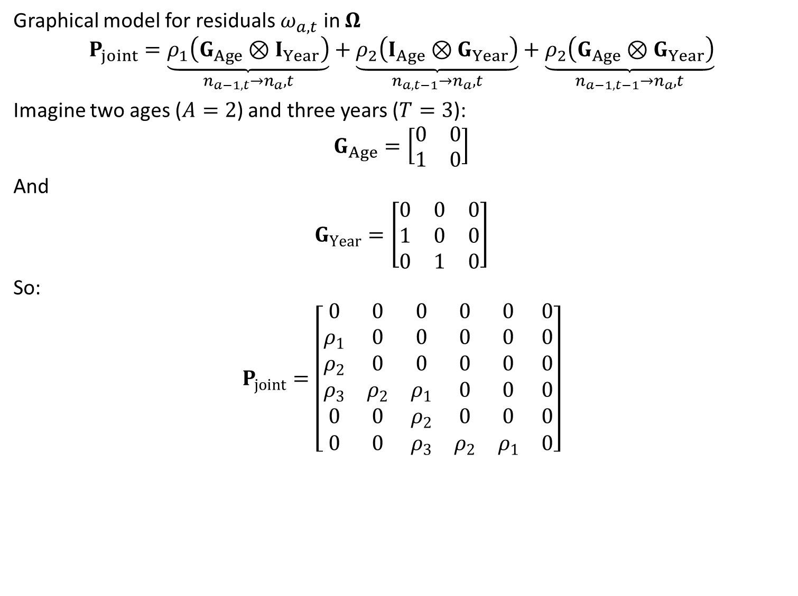
Graphical model for residuals $ω_{a,t}$ in $Ω$
$$P_{joint}=\underset{n_{a−1,t}→n_{a},t}{\underbrace{ρ_{1}\left(G_{Age}⊗I_{Year}\right)}}+\underset{n_{a,t−1}→n_{a},t}{\underbrace{ρ_{2}\left(I_{Age}⊗G_{Year}\right)}}+\underset{n_{a−1,t−1}→n_{a},t}{\underbrace{ρ_{2}\left(G_{Age}⊗G_{Year}\right)}}$$
Imagine two ages ($A=2$) and three years ($T=3$):
$$G_{Age}=\left[\begin{matrix}0 & 0 \\ 1 & 0\end{matrix}\right]$$
And
$$G_{Year}=\left[\begin{matrix}0 & 0 & 0 \\ 1 & 0 & 0 \\ 0 & 1 & 0\end{matrix}\right]$$
So:
$$P_{joint}=\left[\begin{matrix}0 & 0 & 0 & 0 & 0 & 0 \\ ρ_{1} & 0 & 0 & 0 & 0 & 0 \\ ρ_{2} & 0 & 0 & 0 & 0 & 0 \\ ρ_{3} & ρ_{2} & ρ_{1} & 0 & 0 & 0 \\ 0 & 0 & ρ_{2} & 0 & 0 & 0 \\ 0 & 0 & ρ_{3} & ρ_{2} & ρ_{1} & 0\end{matrix}\right]$$

Slide 14
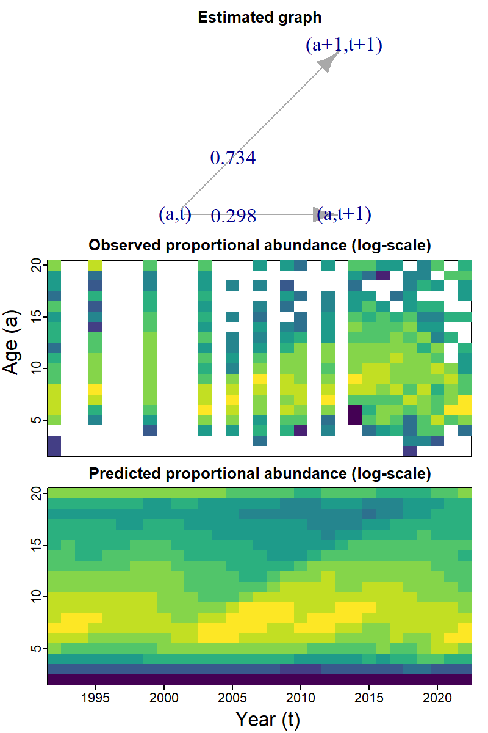
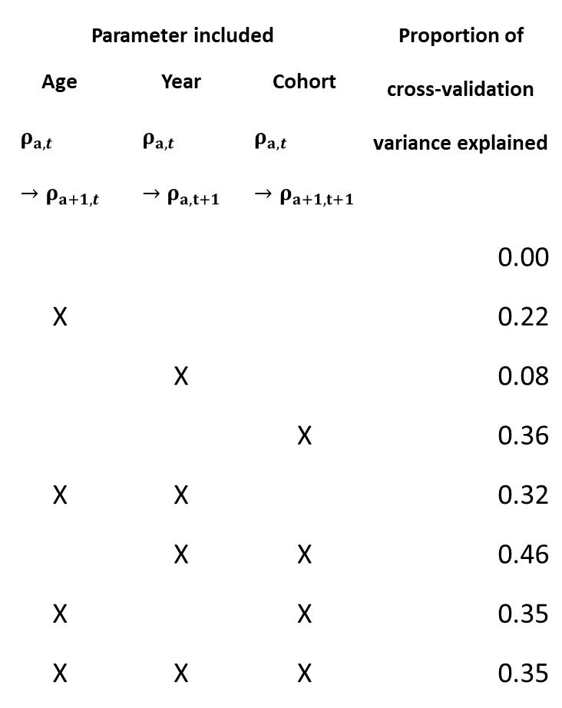
Population dynamics:
Parameter included |  |  | Proportion of cross-validation variance explained
Age $$ρ_{a,t}→ρ_{a+1,t}$$ | Year $$ρ_{a,t}→ρ_{a,t+1}$$ | Cohort $$ρ_{a,t}→ρ_{a+1,t+1}$$
 |  |  | 0.00
X |  |  | 0.22
 | X |  | 0.08
 |  | X | 0.36
X | X |  | 0.32
 | X | X | 0.46
X |  | X | 0.35
X | X | X | 0.35

Slide 15
Phylogenetic comparative methods:
Using VertLife for dated phylogeny
Uses molecular markers and fossils to calibrate times since divergence
Using PanTHERIA for traits
4999 species matched against phylogeny
Question:
How does metabolic rate and adult home range scale with body size?
 | ln_metabolism | ln_range | ln_size
ln_metabolism | 547
ln_range | 233 | 661
ln_size | 547 | 658 | 3340

Slide 16
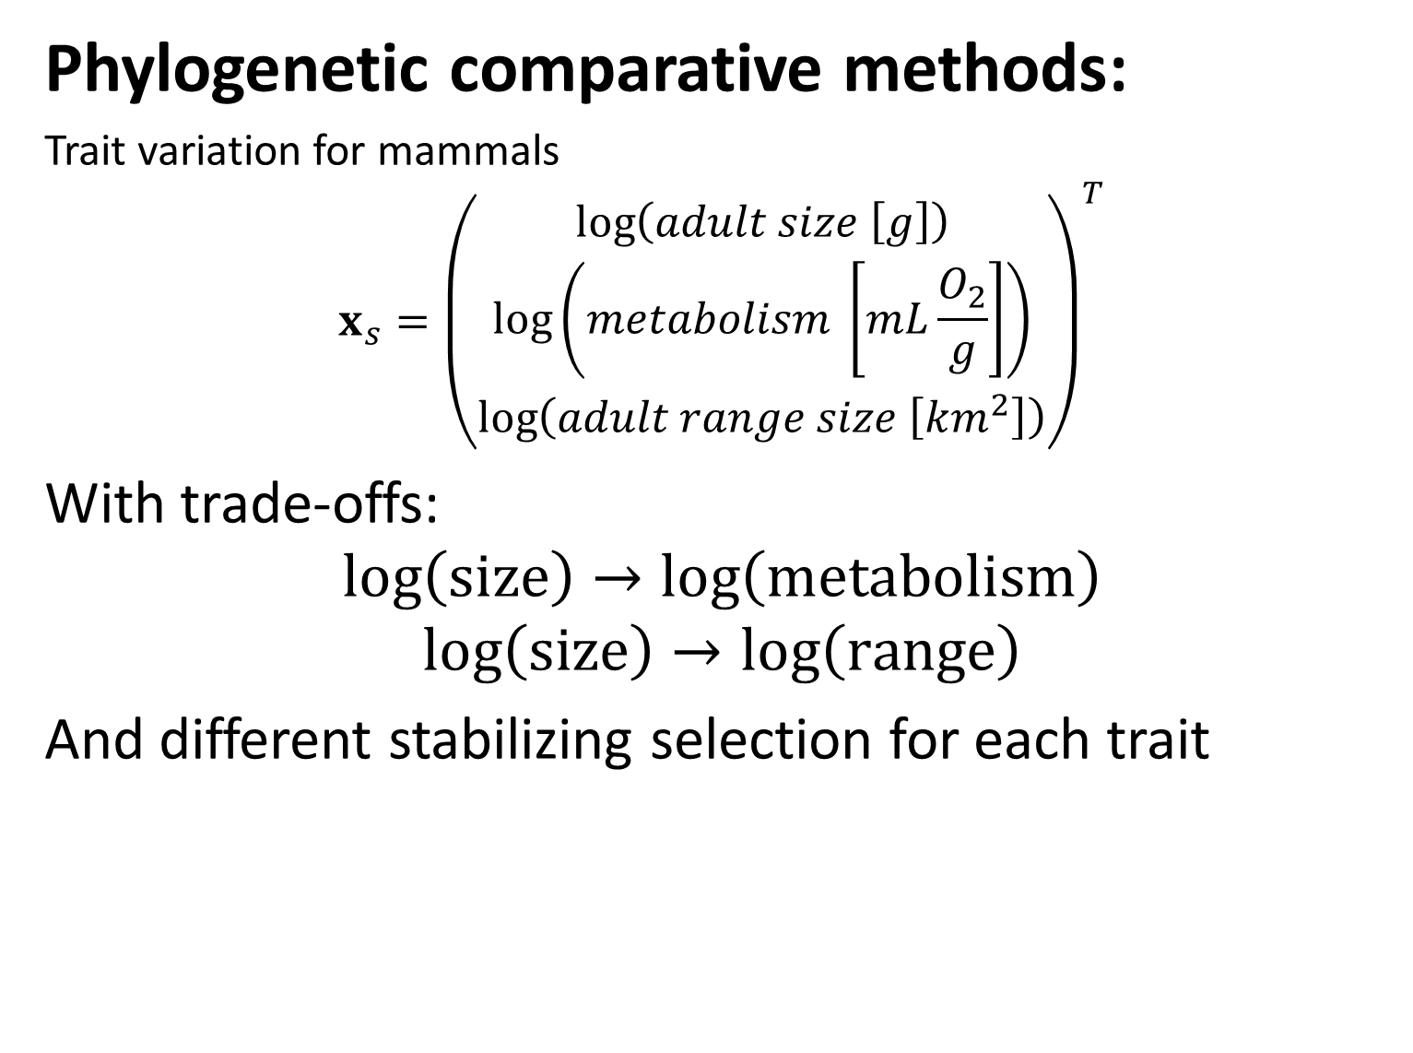
Phylogenetic comparative methods:
Trait variation for mammals
$$x_{s}={\left(\begin{matrix}\log\left(adult size \left[g\right]\right) \\ \log\left(metabolism \left[mL\frac{O_{2}}{g}\right]\right) \\ \log\left(adult range size \left[km^{2}\right]\right)\end{matrix}\right)}^{T}$$
With trade-offs:
$$log\left(size\right)→\log\left(metabolism\right)$$
$$log\left(size\right)→\log\left(range\right)$$
And different stabilizing selection for each trait

Slide 17
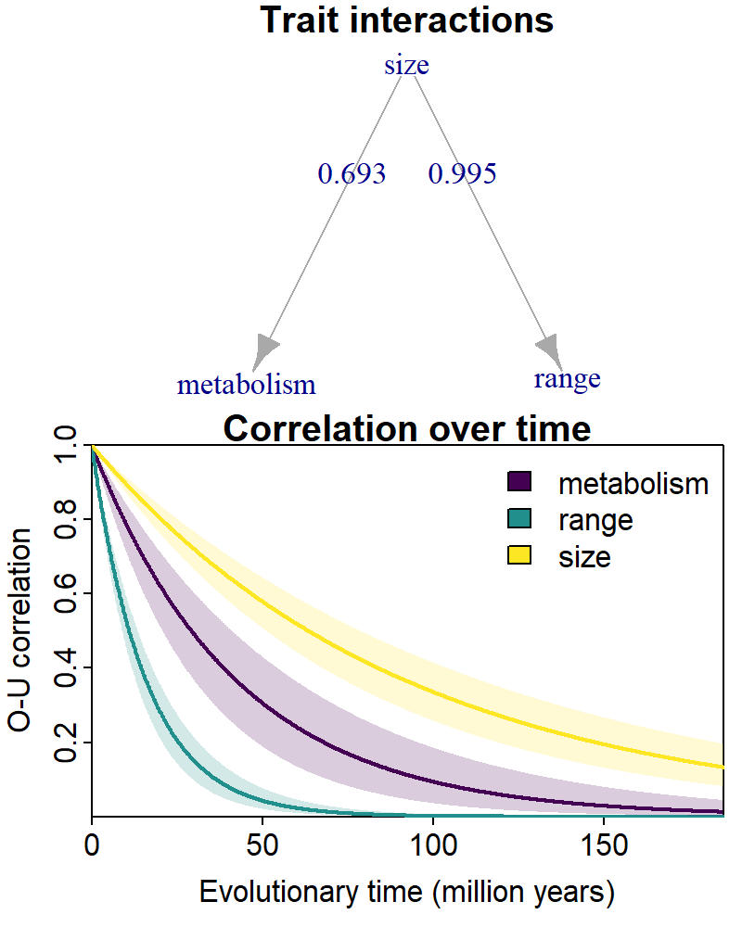
Phylogenetic comparative methods:
Results
Range size is proportion to body size
Metabolism is approximate 2/3 scaling with size
Body size has weak stabilizing selection
Range size has strong stabilizing selection conditional on size

Slide 18
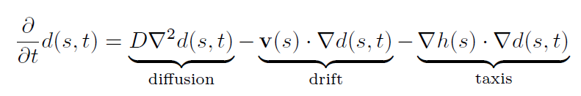
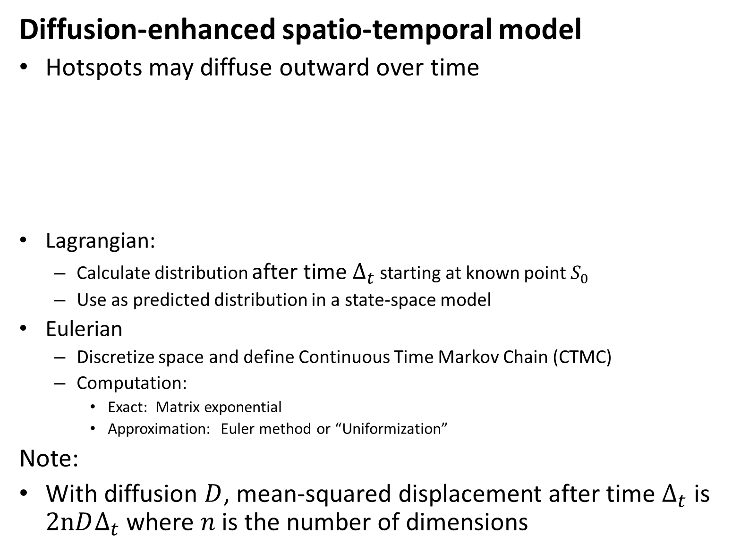
Diffusion-enhanced spatio-temporal model
Hotspots may diffuse outward over time
Lagrangian:
Calculate distribution after time $Δ_{t}$ starting at known point $S_{0}$
Use as predicted distribution in a state-space model
Eulerian
Discretize space and define Continuous Time Markov Chain (CTMC)
Computation:
Exact: Matrix exponential
Approximation: Euler method or “Uniformization”
Note:
With diffusion $D$, mean-squared displacement after time $Δ_{t}$ is $2nDΔ_{t}$ where $n$ is the number of dimensions

Slide 19
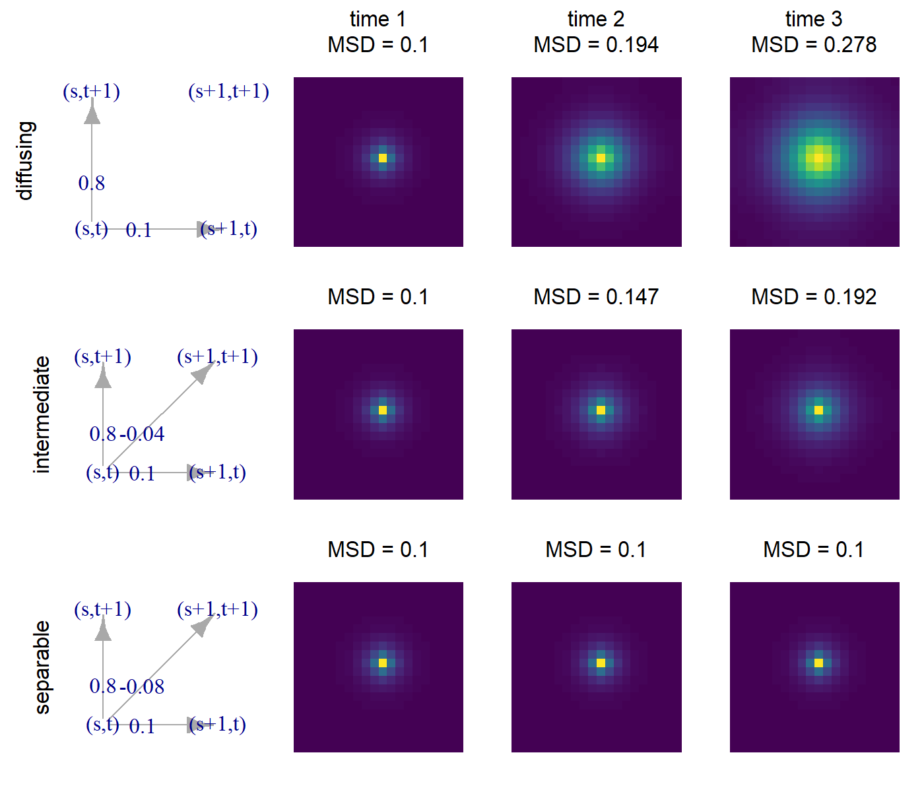

Diffusion-enhanced spatio-temporal model
Model density $d_{s,t}$
$$P_{joint}=\underset{d_{s,t}→d_{s+1,t}}{\underbrace{ρ_{1}\left(I_{time}⊗P_{diffusion}\right)}}+\underset{d_{s,t}→d_{s,t+1}}{\underbrace{ρ_{2}\left(G_{time}⊗I_{space}\right)}}+\underset{d_{s,t}→d_{s+1,t+1}}{\underbrace{ρ_{3}\left(G_{time}⊗P_{diffusion}\right)}}$$

Slide 20
Conclusions
Smoothers (e.g., in a GAM) arise from diffusion
Interactions can be combined with evolutionary / spatial / temporal variation
Can get mechanistic interpretation for large models

